Slide 1
translationRecorder v1.2.4
eDITING An oral language project

Slide 2


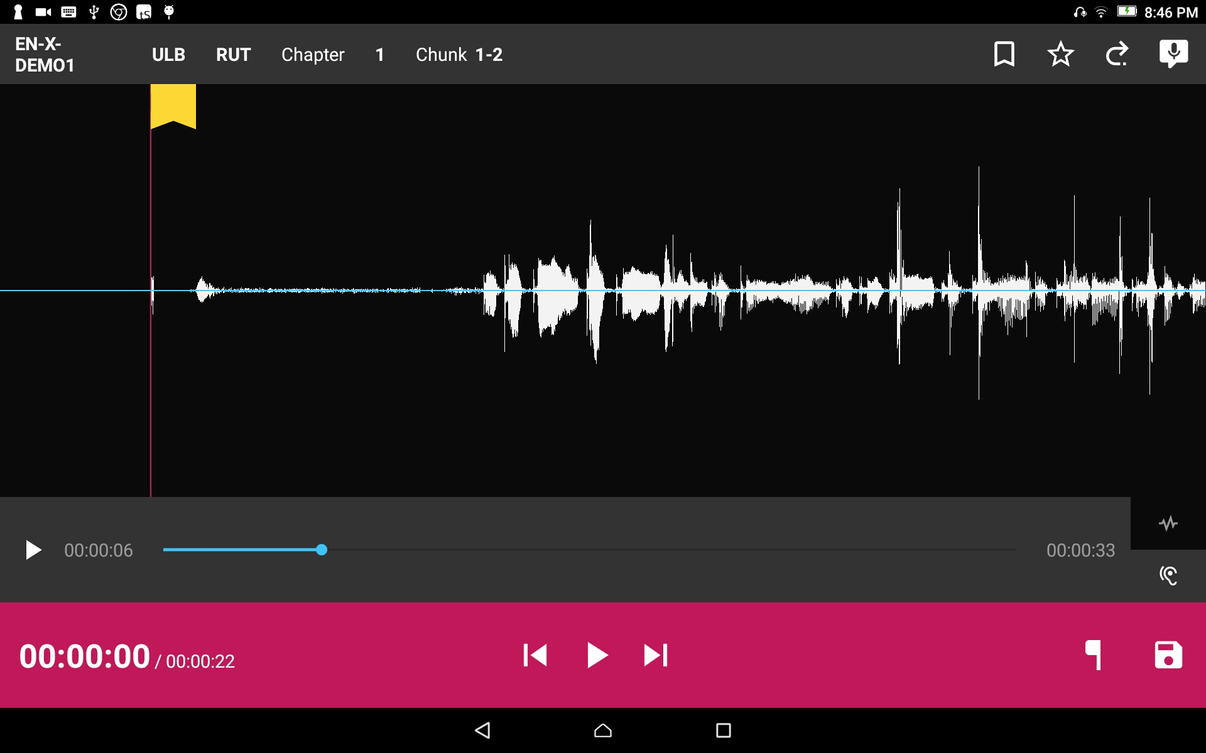
Compare Recording to Source Audio:
To listen to the source audio, tap the listen icon and press the play icon .

Slide 3

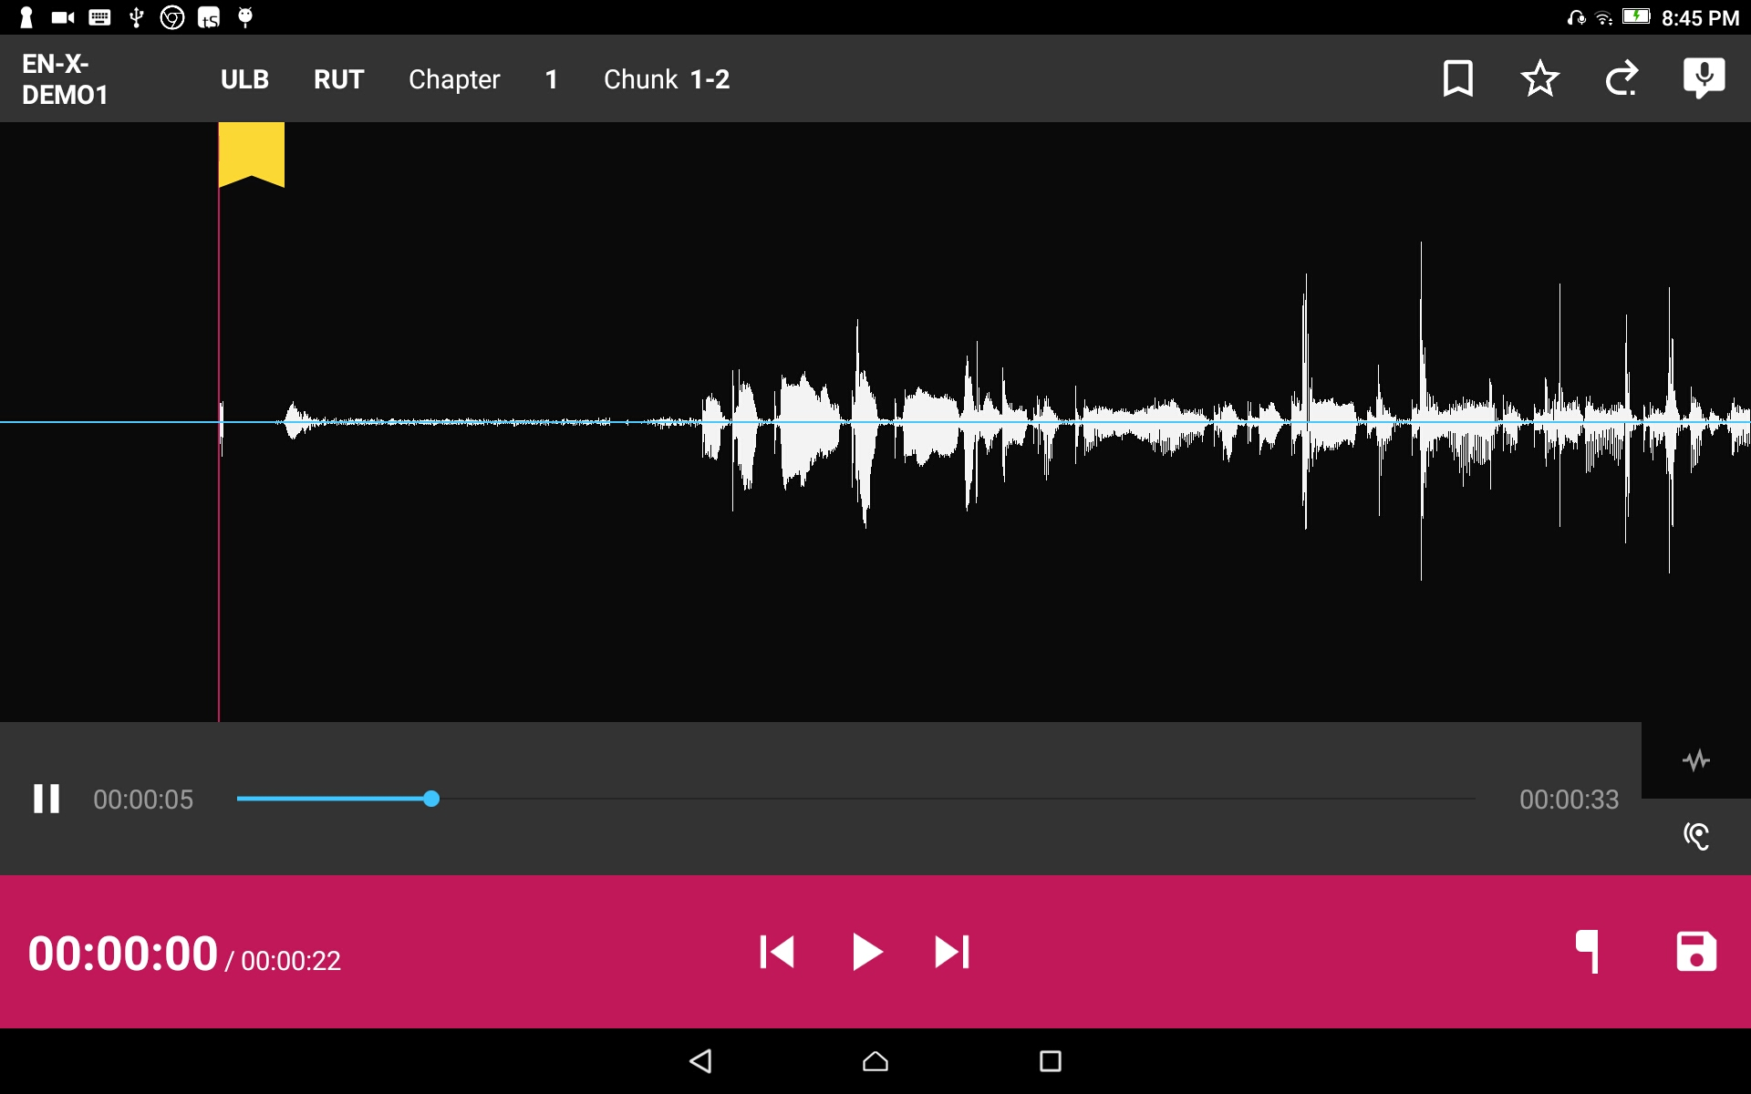
Compare Recording to Source Audio:
Press the pause icon to pause the audio.

Slide 4

Compare Recording to Source Audio:
To rewind or fast forward press and hold the dot and slide to the left for rewind or to the right to fast forward.

Slide 5

Compare Recording to Source Audio:
To return to your recording press the wave icon .

Slide 6
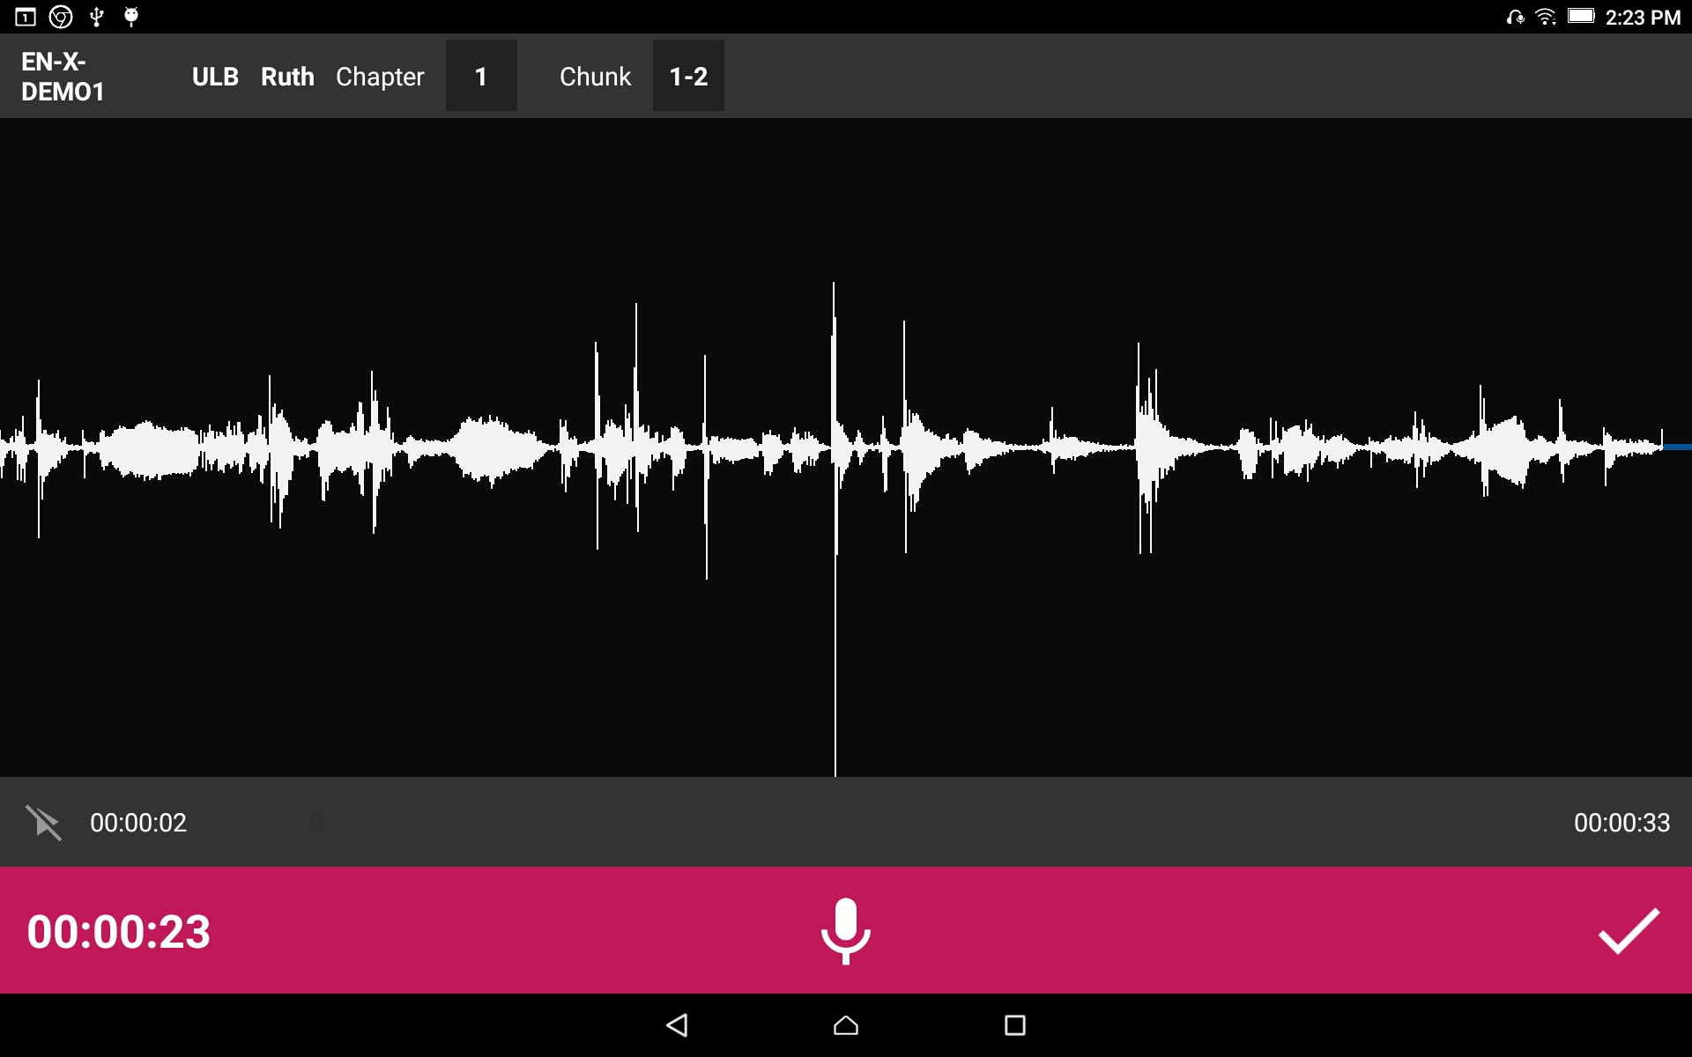
Editing:
Tap the checkmark to save the recording.

Slide 7



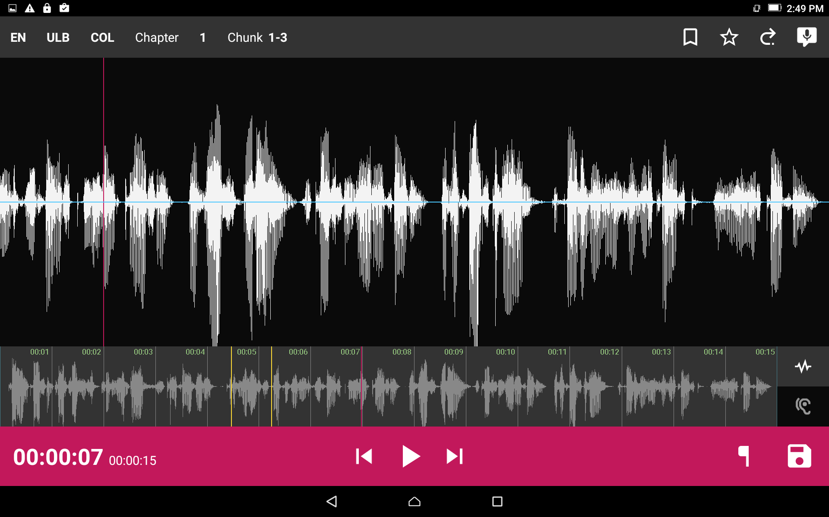
Editing:
To replay your recording simply press the play button .
To rewind the recording press and to fast forward press .

Slide 8

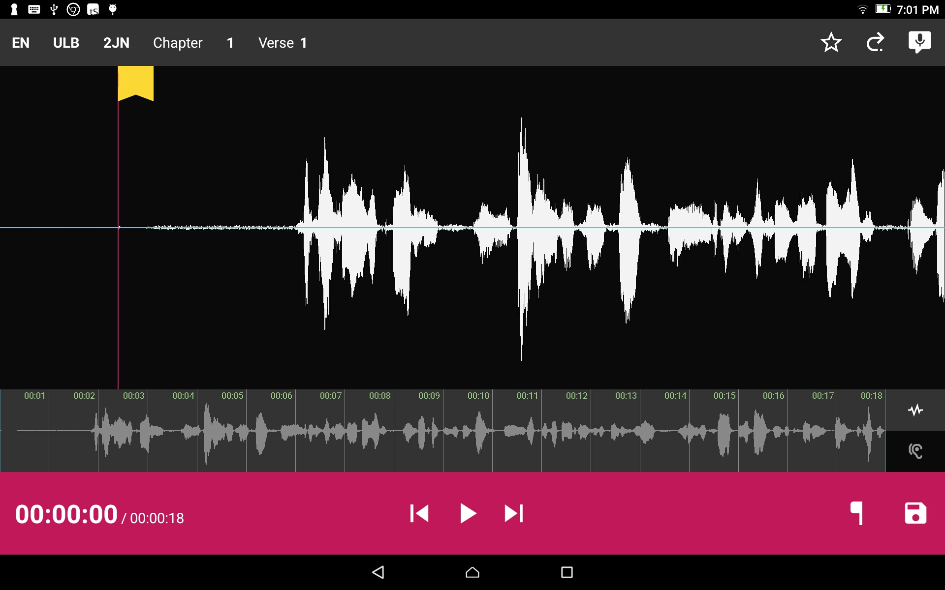
Remove a section of recording:
Position the audio at the thin red line for the beginning of the recording to be removed. Press the button.

Slide 9

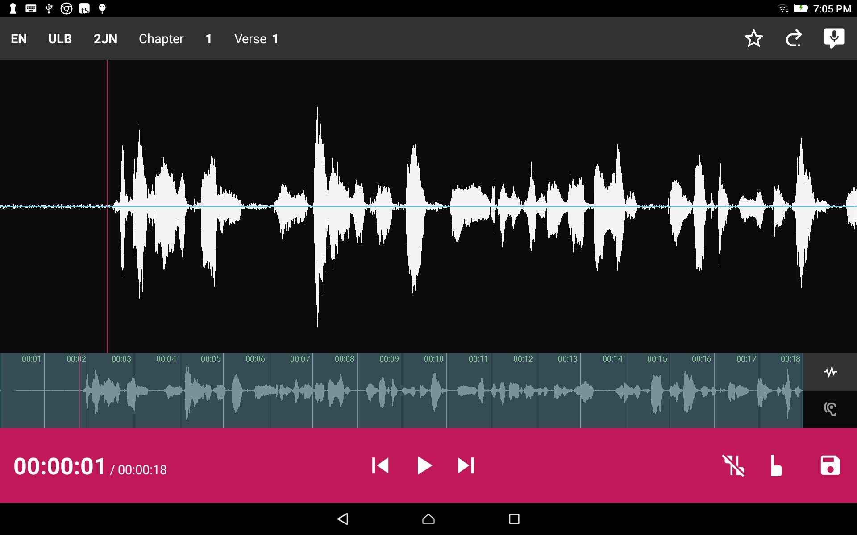

Remove a section of recording:
Use a press-drag motion and position the audio at the thin red line for the end of the recording to be removed. Press the button.
Tap the
to remove edit markings.

Slide 10

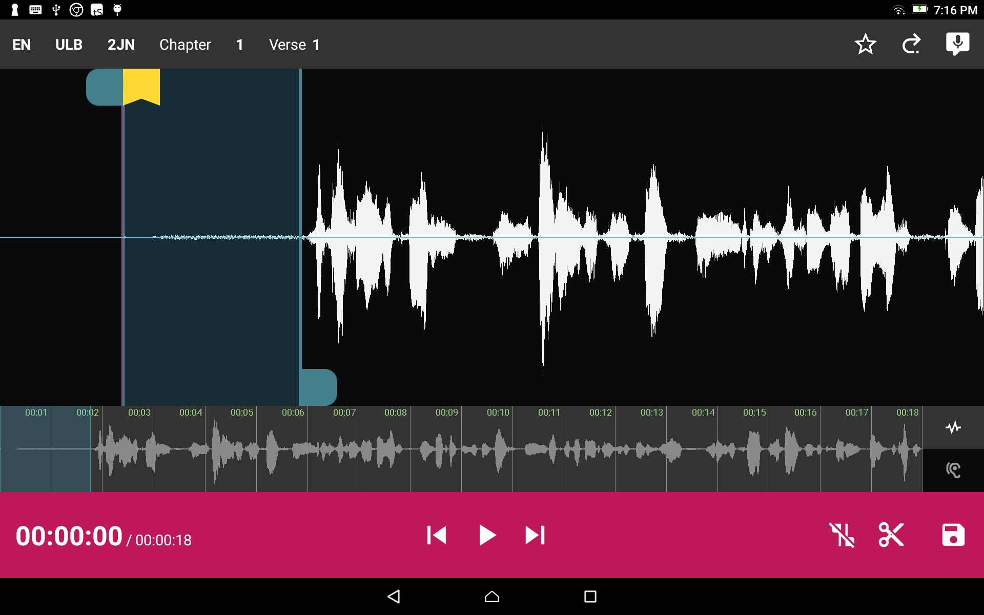
Remove a section of recording:
Use a press-drag to move the blue tab (optional.) to move the edit line.
Press the scissor icon.
Tap the
to remove edit markings.

Slide 11
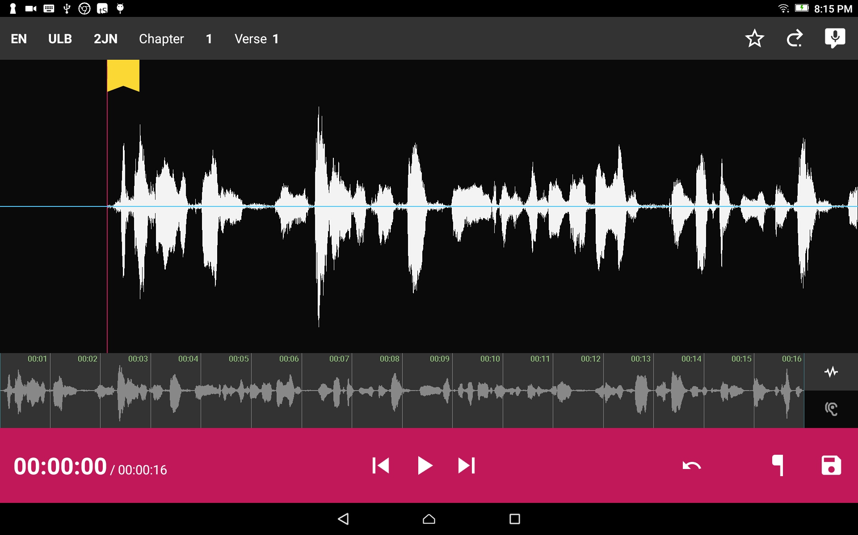
Remove a section of recording:
Press the disc icon to save the recording.

Slide 12

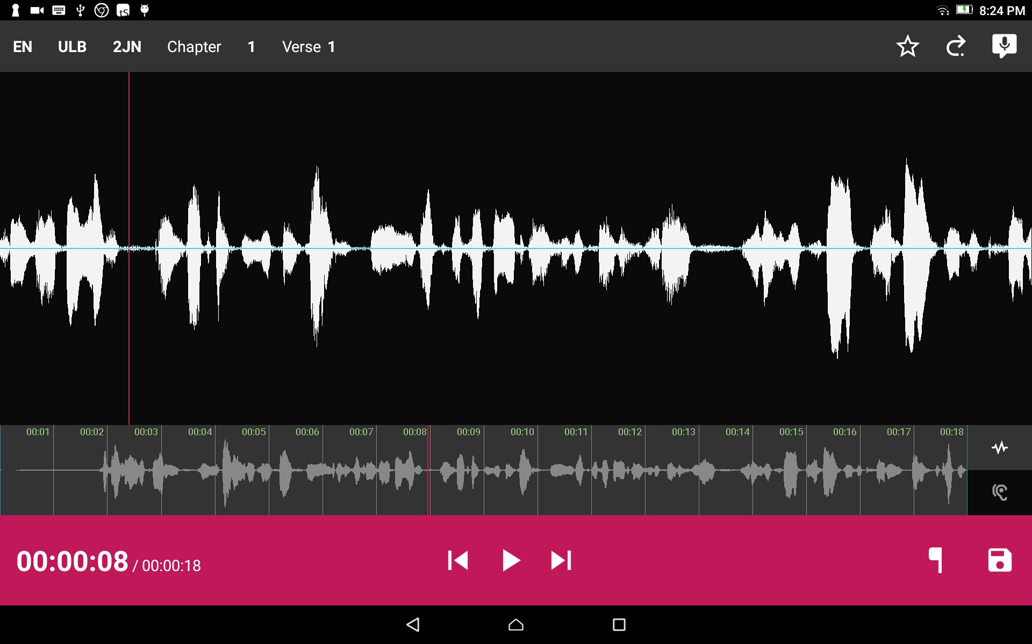
Add a recording piece into the recording:
Position the audio at the thin red line for where the new audio will be added in. Tap the Microphone icon to start a new recording session.

Slide 13
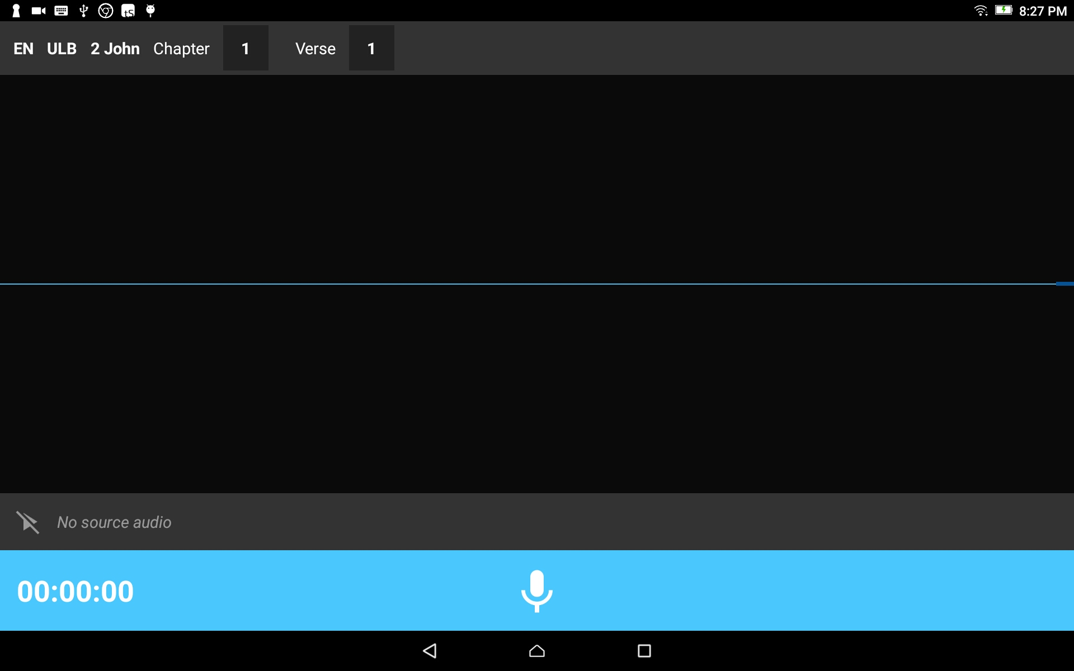
Add a recording piece into the recording:
The insert audio recording screen opens.
Tap the Microphone icon on the blue bar.

Slide 14
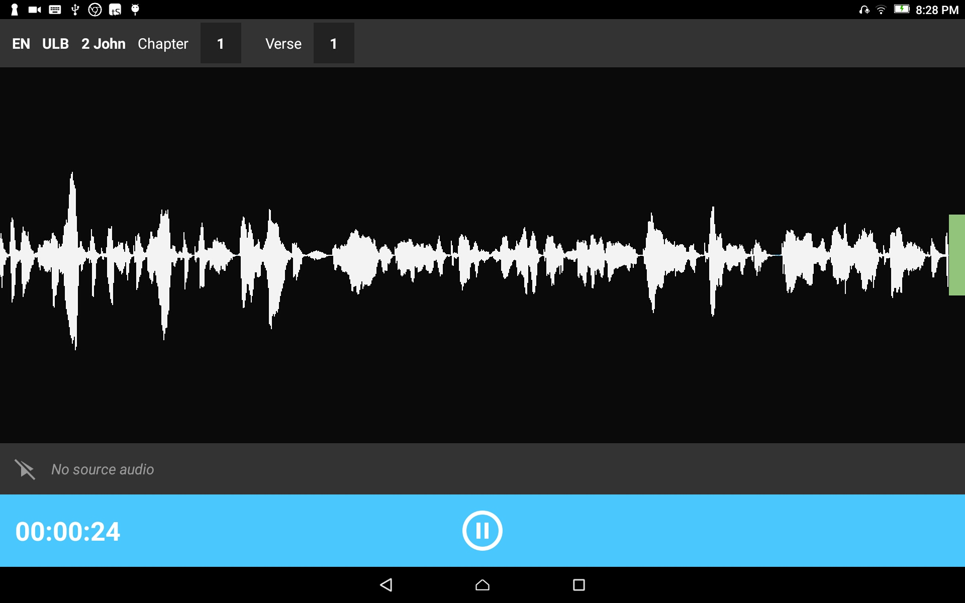
Add a recording piece into the recording:
Tap the pause icon to stop the recording.

Slide 15
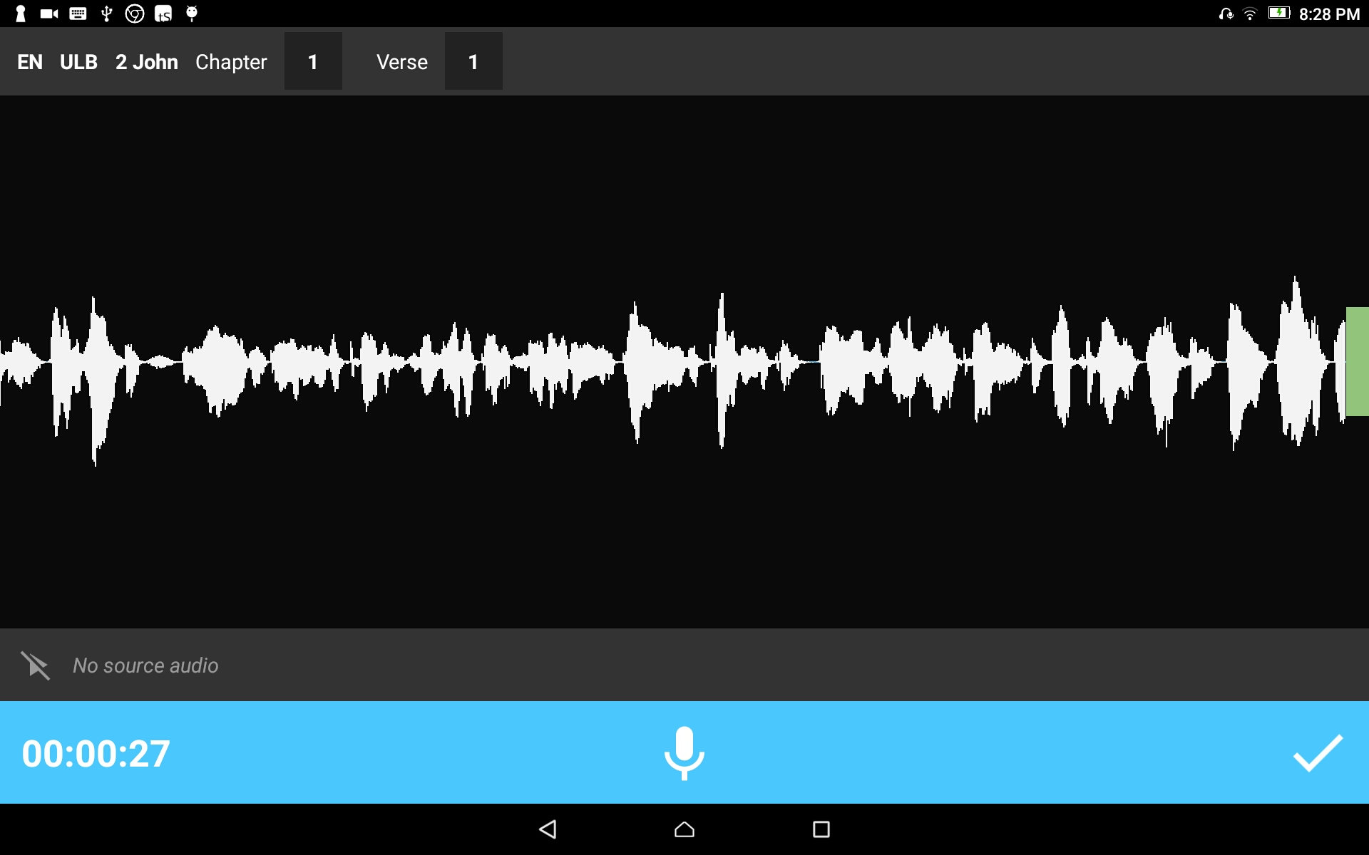
Add a recording piece into the recording:
Tap the check icon to save the recording.

Slide 16
Add a recording piece into the recording:
The main recording opens.
Tap the Play icon to play the audio with the new inserted recording.

Slide 17
Add a recording piece into the recording:
Tap the Save icon to save the recording.

